Slide 1
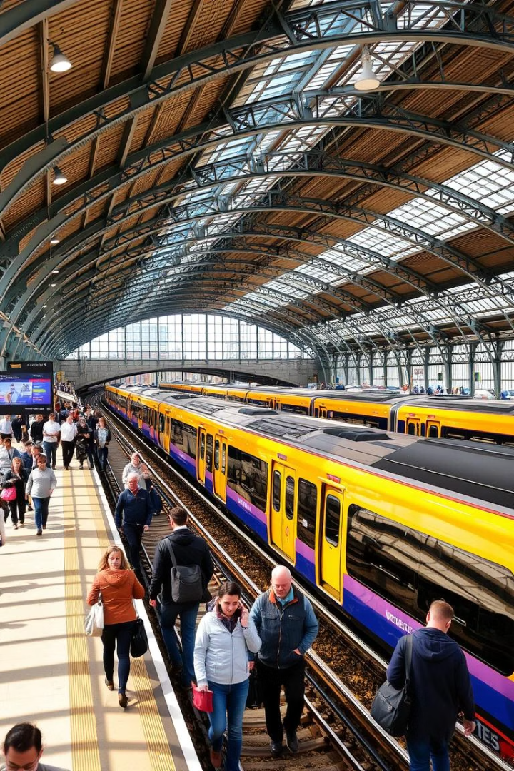
UK Train Rides: Data Insights and Analysis
This presentation delves into the comprehensive dataset of UK train rides to provide data analysts with crucial insights. We will explore ticket purchase patterns, journey details, and train punctuality. By the end, analysts will be equipped to uncover trends in passenger behaviour and identify operational challenges using the train data effectively.
Understanding this data is key for optimising services and improving passenger experiences across the UK rail network.

Slide 2
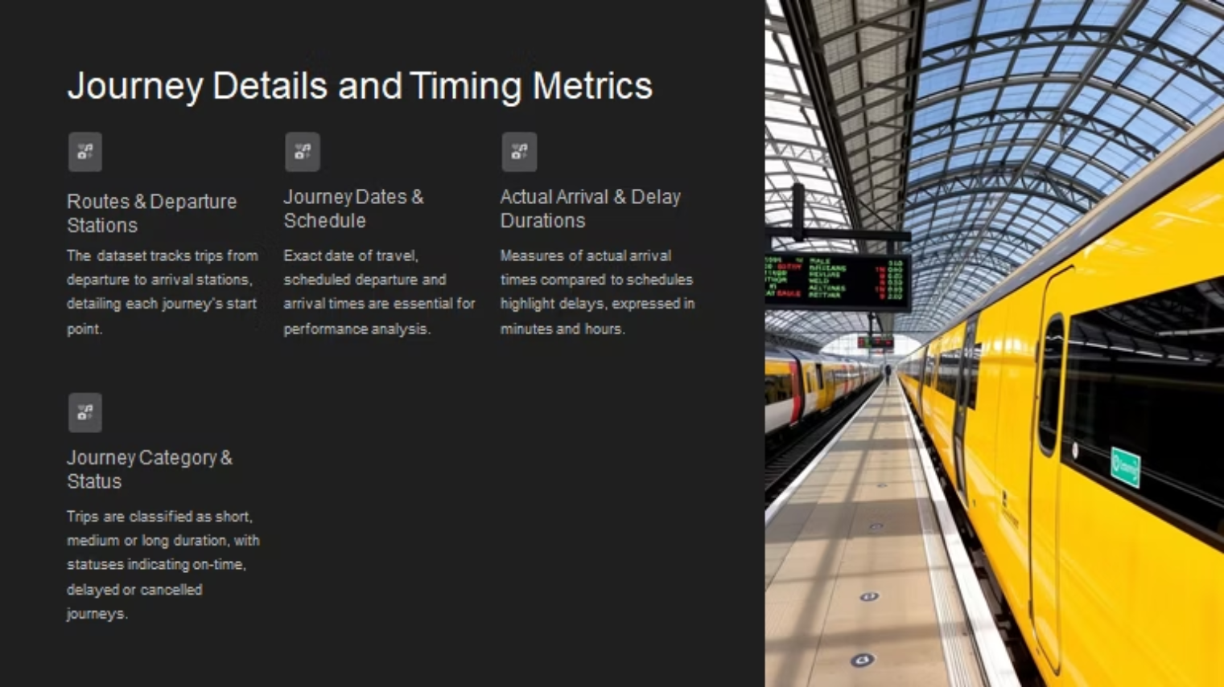

Slide 3
Columns:
1-transaction id: identify the id of each person who bought a train ticket.
2- date of purchase: the time that the purchase transaction occurs
3-purchase type: is it online or from the train station.
4-payment method: credit, debit, contactless or cash.
5-railcard: available for (adults, seniors, disabled) it gives them 1/3 discount. And none for those who don’t have a card
6-ticket class: where should the passenger sit in (standards or first class)?
7-ticket type: the type of the ticket
·Advance: give 50% off but should buy it one day before the trip.ive 50% off but should buy it one day before the trip
·Anytime: without offer and at any time of the day
·Off-peak: it has 25% off, but it must be used away from peak times(6:8am) (4:6pm)
8-price: we add a condition column (price range)
If it <50=low
If it<=150=medium
Else=high

Slide 4
9-routes: it represents the trips from which station to which station?
10-departure station: the station from which the train departed.
11-date of journey: the day of the trip
12-departure & arrival time: train departure and arrival time.
13-actual arrival time: custom column (duration total hours) is the actual time the train arrived, add custom: (departure time)
Custom column (duration total minute): represent the train delay time, add custom: expected arrival time.
14-category of journey: conditional column
if the trip duration <30minutes=short trip
if the trip<=30minutes= medium
if else=long journey
15-journey status: represent the status of the trips if they arrive on time, are delayed or cancelled.
16-reason for delay: the nulls represent the trips that arrived on time, so we replace the nulls with no delay.
17-refund request: represent if the passenger requests a refund due to a train delay.

Slide 5
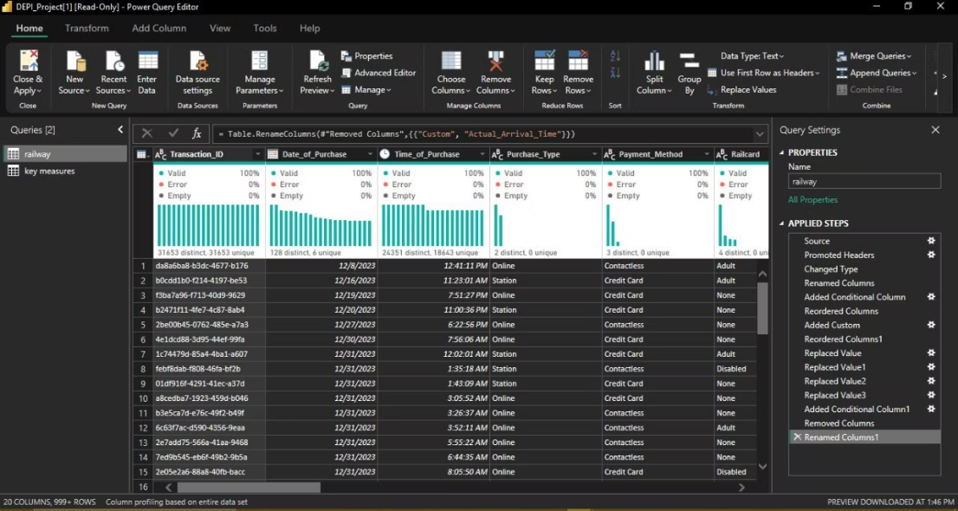

Slide 6
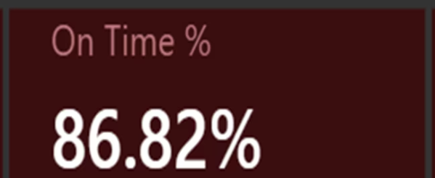
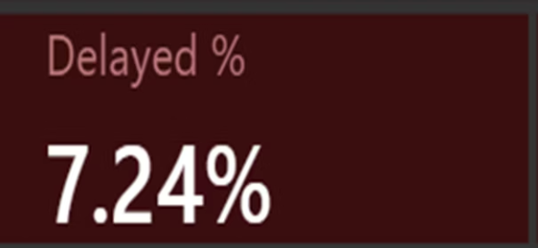
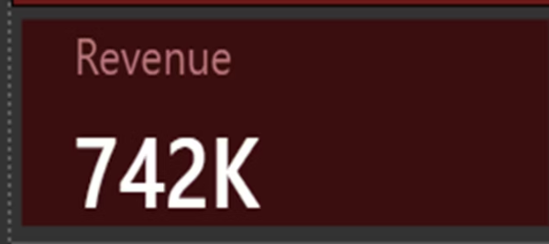
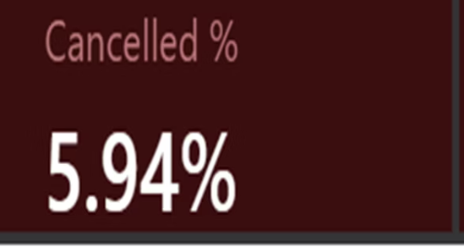
Journey Status: On Time, Delayed, or Cancelled
The journey status data breakdown highlights the proportion of train rides that were cancelled, arrived on time, or experienced delays. This data is essential for performance audits and identifying punctuality challenges within the rail network.

Slide 7
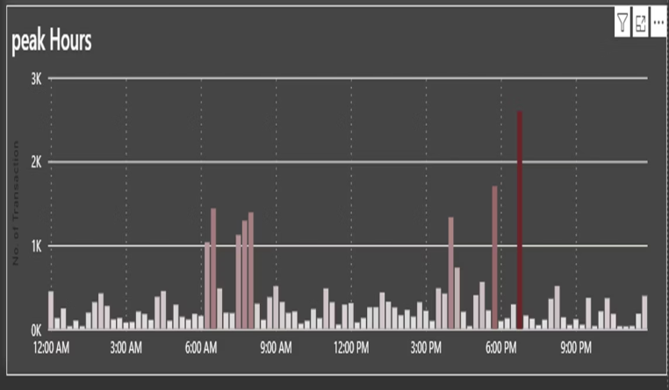
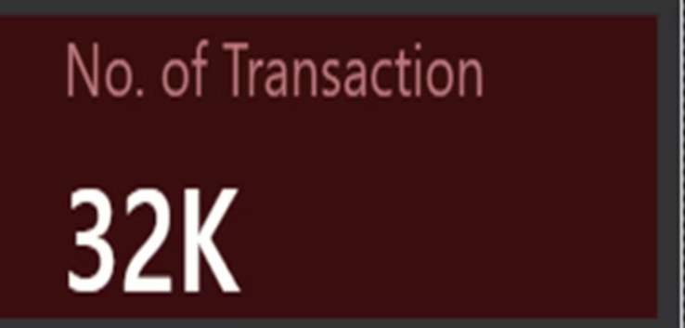
Train Journey Performance Summary
Journey Status
Number of Transactions
On Time
Count of all journeys marked on time
Delayed
Count of delayed train journeys
Cancelled
Count of cancelled journeys
This summary consolidates key performance indicators, comparing timely arrivals, delays, and cancellations to identify operational strengths and weaknesses in the UK rail system.

Slide 8
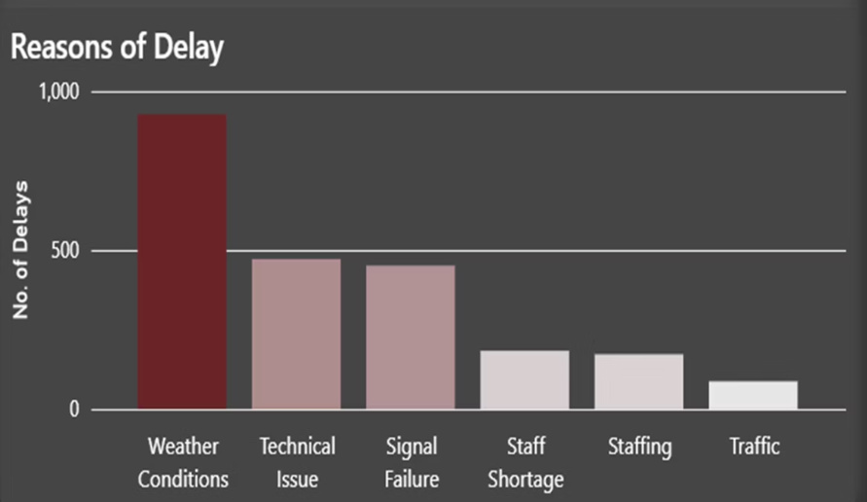
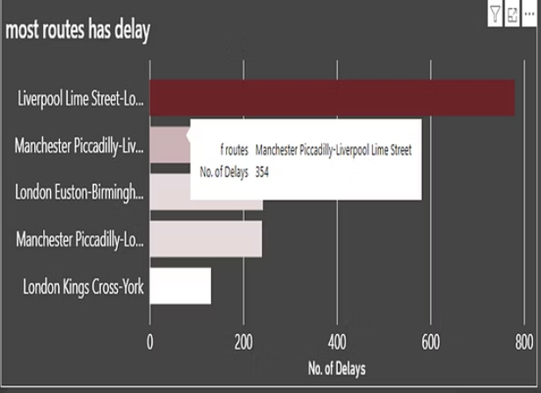
Factors Affecting Train Delays
Examining delay causes is fundamental to improving train punctuality. Common reasons documented include signal failures, track maintenance, and weather disruptions. Understanding frequency and impact of each cause guides targeted interventions and resource allocation.

Slide 9
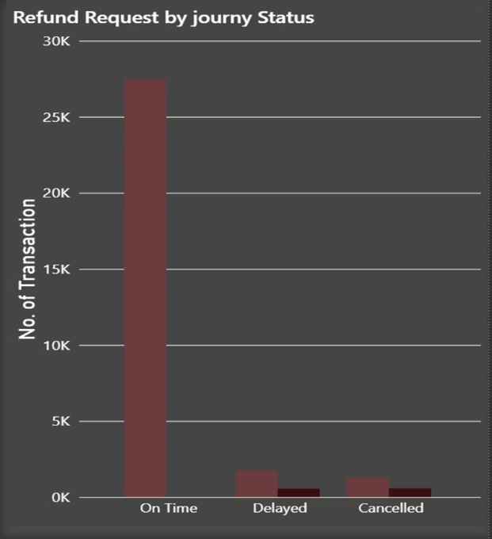
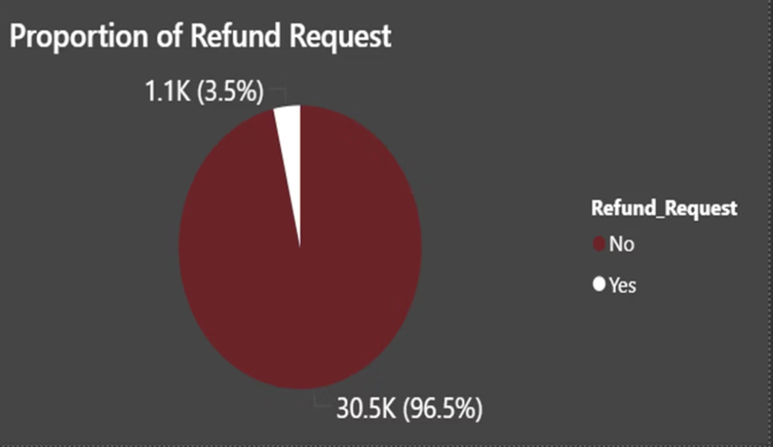
Refund Requests Due to Delays
Refund claims are predominantly requested by passengers affected by significant delays. Analysing refunds relative to delay reasons helps assess customer dissatisfaction and operational financial impacts. This insight informs enhanced customer service policies.

Slide 10
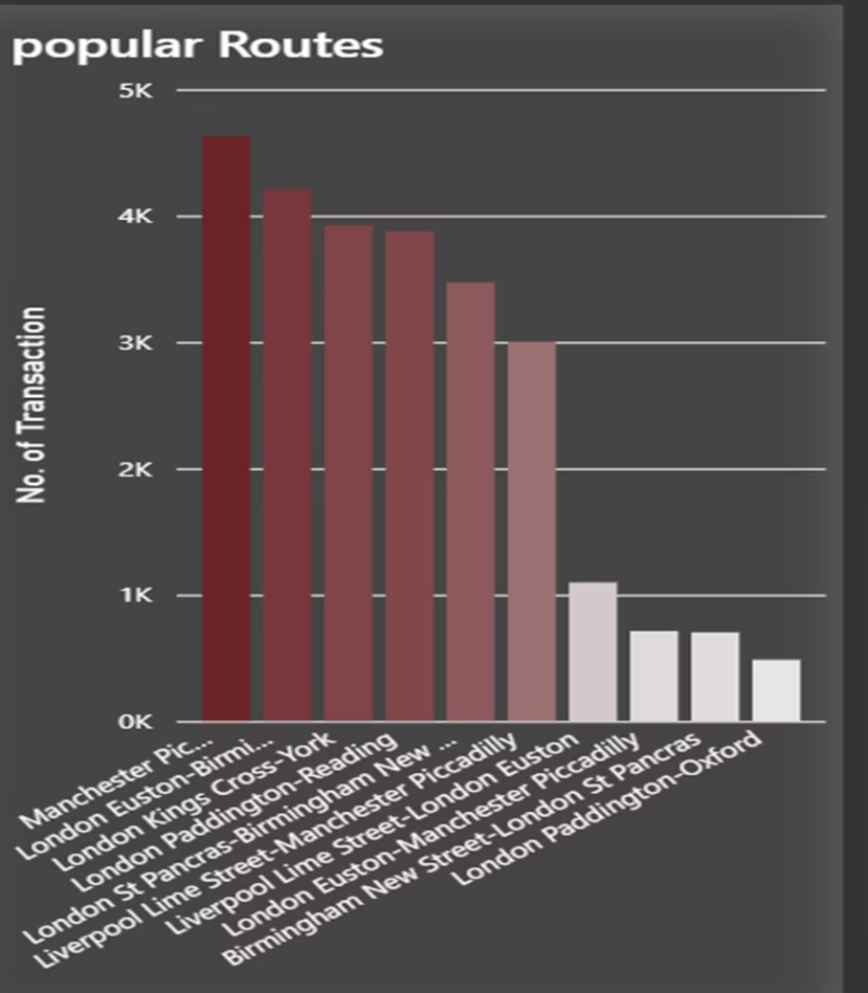
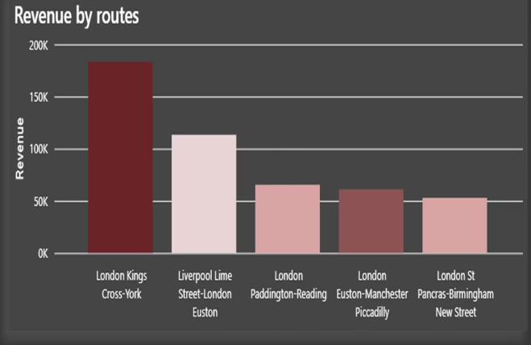
Popular Routes and Travel Patterns
Route analysis reveals passenger preferences and key transit corridors. High-demand segments guide capacity planning and scheduling priorities to optimise new
ork efficiency and passenger convenience.

Slide 11
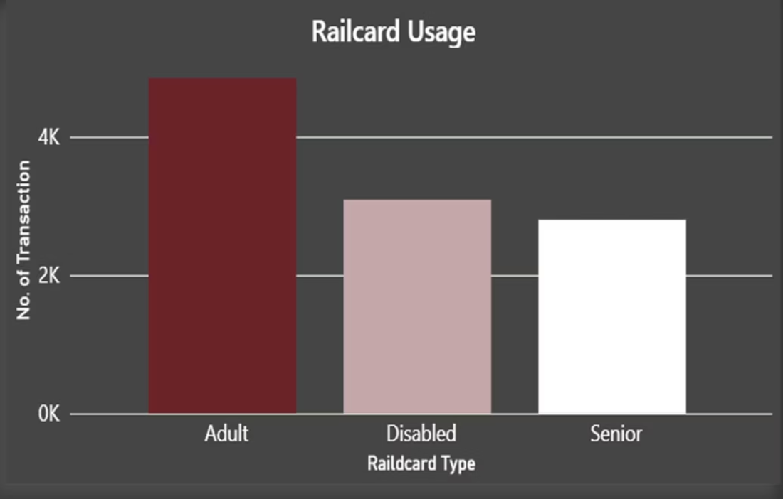
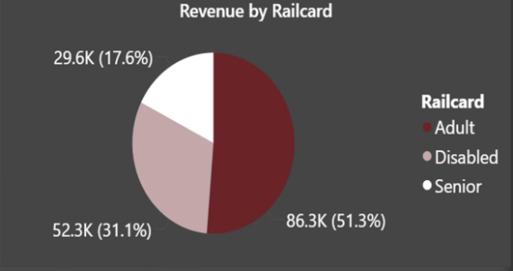
Usage of Railcards and Their Effects on Pricing
Railcards provide discounts primarily benefiting adults, seniors, and disabled passengers, influencing purchasing patterns and ticket price distributions.
Analyzing railcard adoption alongside ticket prices reveals how passengers optimise costs and which segments benefit most.

Slide 12
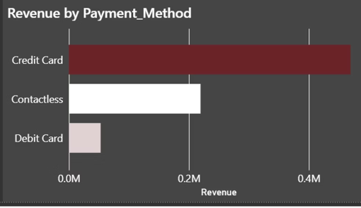
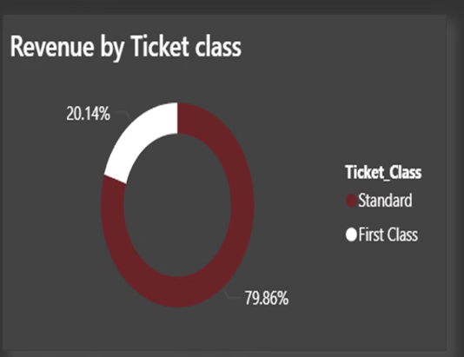
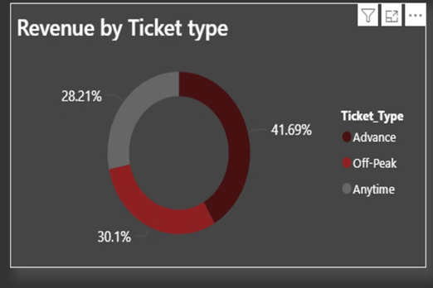
Revenues Affects

Slide 13
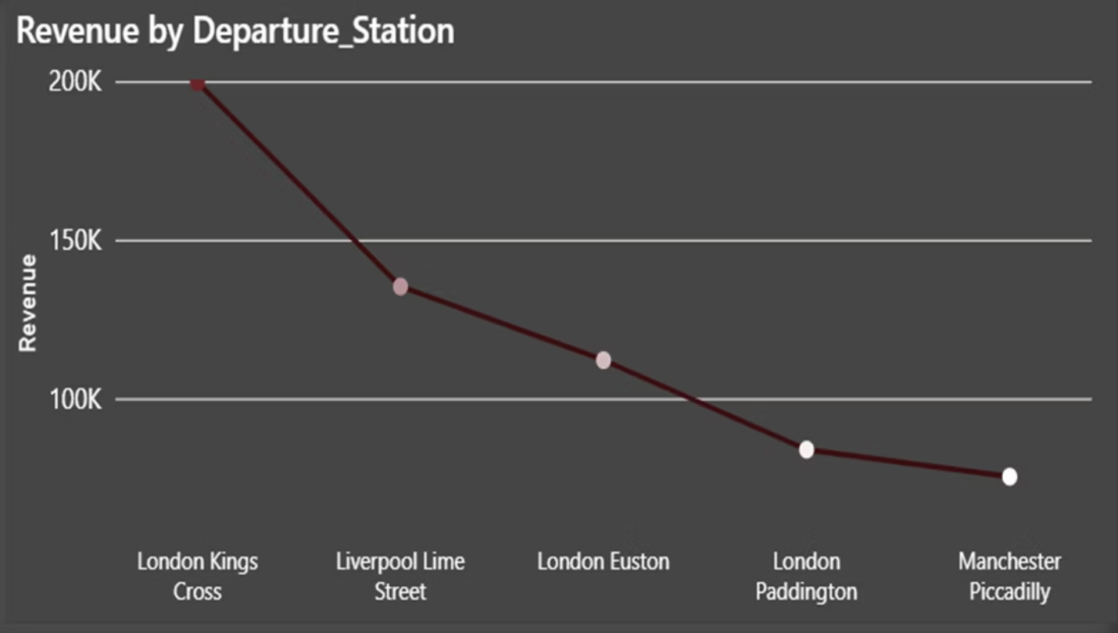
Revenue Leaders:
London Kings Cross generates the highest revenue (£200K), followed by Liverpool Lime Street (£150K).
London stations collectively dominate the revenue share.
Opportunities for Growth:
Lower-revenue stations (e.g., Manchester, Street) may need targeted marketing or service improvements.
Investigate why some London stations (e.g., Paddington, Piccadilly) underperform compared to Kings Cross.
Recommendations:
Prioritize maintenance and upgrades for high-revenue stations to sustain performance.
Explore partnerships or promotions to boost traffic at underperforming stations.

Slide 14
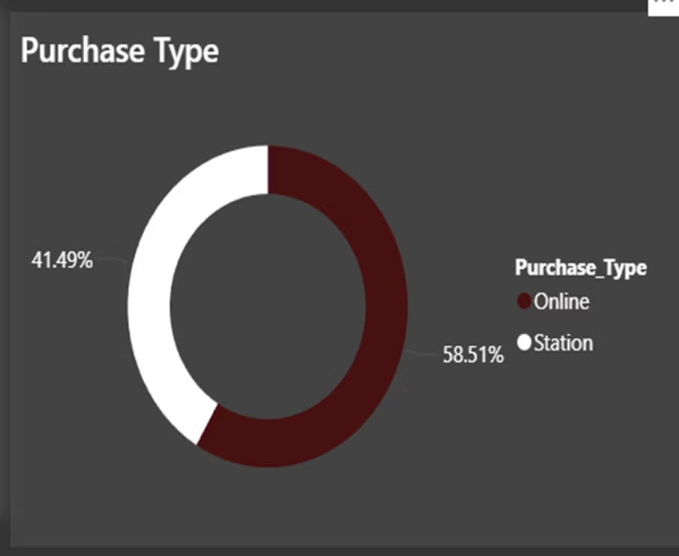
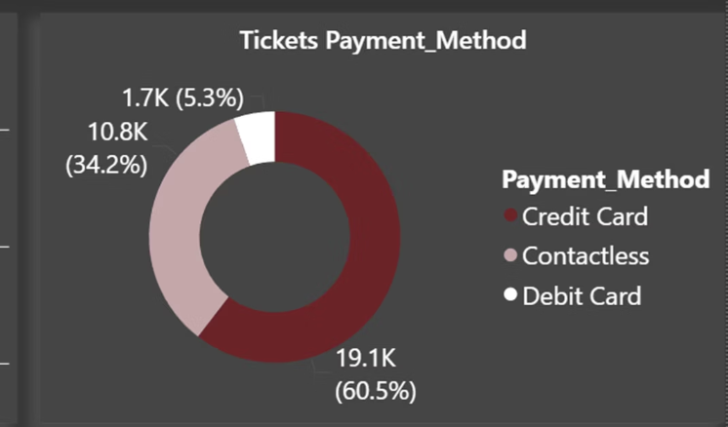
payment methods and types

